Slide 1
FAIMSFB Coil assembly details
Feb 25, 2020

Slide 2
Fly-back transformer cores
Digikey 495-5250-ND, RM8 630nH cores
Digikey 495-5262-ND RM8 clamps
Use PCB coil boards and build as shown on next slides
Require 2 transformers per DMS system

Slide 3
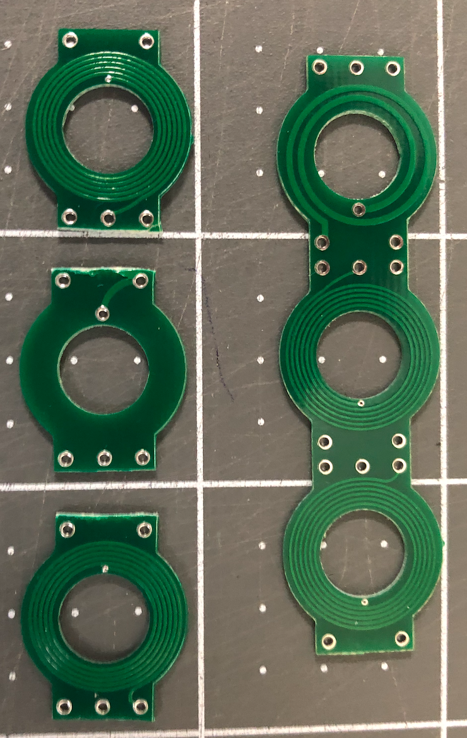

Slide 4
